Slide 1

William Stallings Computer Organization and Architecture 10th Edition
Notes:
Lecture slides prepared for “Computer Organization and Architecture”, 10/e, by William Stallings, Chapter 13 “Instruction Sets: Addressing Modes and Formats”.

Slide 2
Objectives
Understand Virtual Memory
Reinforce the concept of page, Frame
Understand virtual address
Understand physical address

Slide 3
Memory Management
Paging
Before : Unequal size and Variable size partitions → inefficient
NOW:
Memory (divided into) → FRAMES (Page Frames)
Process (divided into) → Pages
Notes:
Both unequal fixed-size and variable-size partitions are inefficient in the use of
memory. Suppose, however, that memory is partitioned into equal fixed-size chunks
that are relatively small, and that each process is also divided into small fixed-size
chunks of some size. Then the chunks of a program, known as pages, could be
assigned to available chunks of memory, known as frames, or page frames. At most,
then, the wasted space in memory for that process is a fraction of the last page.
Figure 8.15 shows an example of the use of pages and frames. At a given point
in time, some of the frames in memory are in use and some are free. The list of free
frames is maintained by the OS. Process A, stored on disk, consists of four pages.
When it comes time to load this process, the OS finds four free frames and loads the
four pages of the process A into the four frames.

Slide 4
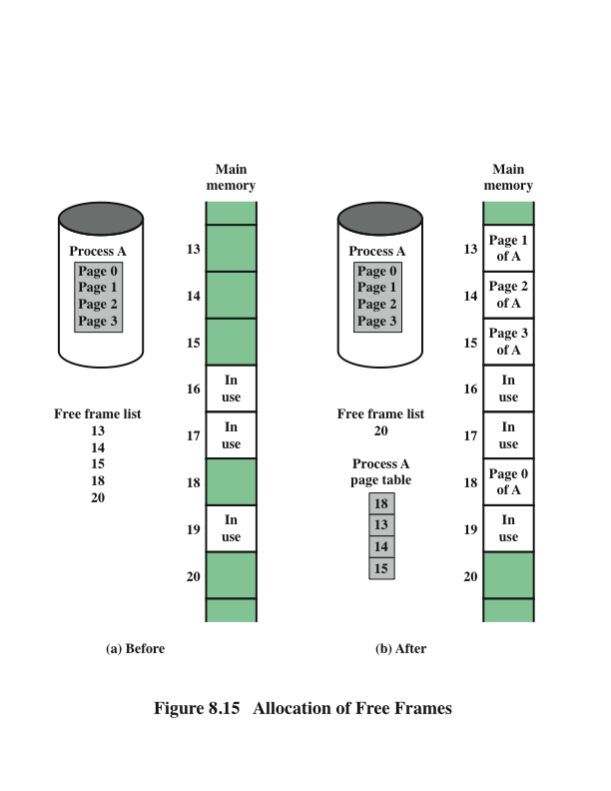
Memory Management
Paging
Frame = Page Frame
Maintained by the OS
Maintained by the OS
* 1 Per Process
Notes:
Both unequal fixed-size and variable-size partitions are inefficient in the use of
memory. Suppose, however, that memory is partitioned into equal fixed-size chunks
that are relatively small, and that each process is also divided into small fixed-size
chunks of some size. Then the chunks of a program, known as pages, could be
assigned to available chunks of memory, known as frames, or page frames. At most,
then, the wasted space in memory for that process is a fraction of the last page.
Figure 8.15 shows an example of the use of pages and frames. At a given point
in time, some of the frames in memory are in use and some are free. The list of free
frames is maintained by the OS. Process A, stored on disk, consists of four pages.
When it comes time to load this process, the OS finds four free frames and loads the
four pages of the process A into the four frames.

Slide 5
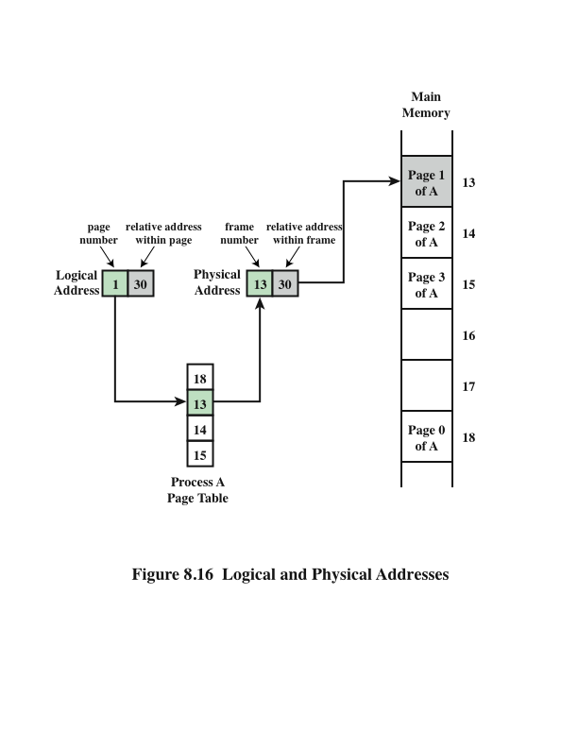
Logical and Physical Addresses Paging
[0]
[1]
[2]
[3]
Maintained by the OS
* 1 Per Process
Notes:
Now suppose, as in this example, that there are not sufficient unused contiguous
frames to hold the process. Does this prevent the OS from loading A?
The answer is no, because we can once again use the concept of logical address. A
simple base address will no longer suffice. Rather, the OS maintains a page table
for each process. The page table shows the frame location for each page of the
process. Within the program, each logical address consists of a page number and
a relative address within the page. Recall that in the case of simple partitioning, a
logical address is the location of a word relative to the beginning of the program;
the processor translates that into a physical address. With paging, the logical-to-
physical address translation is still done by processor hardware. The processor
must know how to access the page table of the current process. Presented with a
logical address (page number, relative address), the processor uses the page table
to produce a physical address (frame number, relative address). An example is
shown in Figure 8.16.
This approach solves the problems raised earlier. Main memory is divided
into many small equal-size frames. Each process is divided into frame-size pages:
smaller processes require fewer pages, larger processes require more. When a
process is brought in, its pages are loaded into available frames, and a page table
is set up.

Slide 6
Virtual Memory
Demand Paging
A refinement to the previous paging scheme
Each page of a process is brought in only when it is needed (on demand)
Why do we need to do this? Answer: Because it is important to contemplate the possibility that a program will not fit in Main Memory. If this is the case, we should be able to execute, because only those parts that will play a role at a given time need to be in Main Memory.
The parts of the program NOT being executed, are usually stored on a high capacity storage device, usually a Hard Disk (magnetic) → (virtual memory)
Notes:
With the use of paging, truly effective multiprogramming
systems came into being. Furthermore, the simple tactic of breaking a process up
into pages led to the development of another important concept: virtual memory.
To understand virtual memory, we must add a refinement to the paging
scheme just discussed. That refinement is demand paging, which simply means that
each page of a process is brought in only when it is needed, that is, on demand.
Consider a large process, consisting of a long program plus a number of arrays
of data. Over any short period of time, execution may be confined to a small section
of the program (e.g., a subroutine), and perhaps only one or two arrays of data
are being used. This is the principle of locality, which we introduced in Appendix
4A. It would clearly be wasteful to load in dozens of pages for that process when
only a few pages will be used before the program is suspended. We can make better
use of memory by loading in just a few pages. Then, if the program branches
to an instruction on a page not in main memory, or if the program references data
on a page not in memory, a page fault is triggered. This tells the OS to bring in the
desired page.
Thus, at any one time, only a few pages of any given process are in memory,
and therefore more processes can be maintained in memory. Furthermore, time is
saved because unused pages are not swapped in and out of memory. However, the
OS must be clever about how it manages this scheme. When it brings one page in, it
must throw another page out; this is known as page replacement. If it throws out a
page just before it is about to be used, then it will just have to go get that page again
almost immediately. Too much of this leads to a condition known as thrashing: the
processor spends most of its time swapping pages rather than executing instructions.
The avoidance of thrashing was a major research area in the 1970s and led to a variety
of complex but effective algorithms. In essence, the OS tries to guess, based on
recent history, which pages are least likely to be used in the near future.
With demand paging, it is not necessary to load an entire process into main
memory. This fact has a remarkable consequence: It is possible for a process to be
larger than all of main memory. One of the most fundamental restrictions in programming
has been lifted. Without demand paging, a programmer must be acutely
aware of how much memory is available. If the program being written is too large,
the programmer must devise ways to structure the program into pieces that can
be loaded one at a time. With demand paging, that job is left to the OS and the
hardware. As far as the programmer is concerned, he or she is dealing with a huge
memory, the size associated with disk storage.
Because a process executes only in main memory, that memory is referred to
as real memory. But a programmer or user perceives a much larger memory—that
which is allocated on the disk. This latter is therefore referred to as virtual memory.
Virtual memory allows for very effective multiprogramming and relieves the user of
the unnecessarily tight constraints of main memory.

Slide 7
Virtual Memory
In a VM system, programs and processor make reference to instructions in an address space that it is INDEPENDENT of the available physical MM space.
The addresses issued by the processor are known as Virtual or Logical Addresses.
Virtual (Logical) Addresses MUST be translated eventually to Physical Addresses
Notes:
With the use of paging, truly effective multiprogramming
systems came into being. Furthermore, the simple tactic of breaking a process up
into pages led to the development of another important concept: virtual memory.
To understand virtual memory, we must add a refinement to the paging
scheme just discussed. That refinement is demand paging, which simply means that
each page of a process is brought in only when it is needed, that is, on demand.
Consider a large process, consisting of a long program plus a number of arrays
of data. Over any short period of time, execution may be confined to a small section
of the program (e.g., a subroutine), and perhaps only one or two arrays of data
are being used. This is the principle of locality, which we introduced in Appendix
4A. It would clearly be wasteful to load in dozens of pages for that process when
only a few pages will be used before the program is suspended. We can make better
use of memory by loading in just a few pages. Then, if the program branches
to an instruction on a page not in main memory, or if the program references data
on a page not in memory, a page fault is triggered. This tells the OS to bring in the
desired page.
Thus, at any one time, only a few pages of any given process are in memory,
and therefore more processes can be maintained in memory. Furthermore, time is
saved because unused pages are not swapped in and out of memory. However, the
OS must be clever about how it manages this scheme. When it brings one page in, it
must throw another page out; this is known as page replacement. If it throws out a
page just before it is about to be used, then it will just have to go get that page again
almost immediately. Too much of this leads to a condition known as thrashing: the
processor spends most of its time swapping pages rather than executing instructions.
The avoidance of thrashing was a major research area in the 1970s and led to a variety
of complex but effective algorithms. In essence, the OS tries to guess, based on
recent history, which pages are least likely to be used in the near future.
With demand paging, it is not necessary to load an entire process into main
memory. This fact has a remarkable consequence: It is possible for a process to be
larger than all of main memory. One of the most fundamental restrictions in programming
has been lifted. Without demand paging, a programmer must be acutely
aware of how much memory is available. If the program being written is too large,
the programmer must devise ways to structure the program into pieces that can
be loaded one at a time. With demand paging, that job is left to the OS and the
hardware. As far as the programmer is concerned, he or she is dealing with a huge
memory, the size associated with disk storage.
Because a process executes only in main memory, that memory is referred to
as real memory. But a programmer or user perceives a much larger memory—that
which is allocated on the disk. This latter is therefore referred to as virtual memory.
Virtual memory allows for very effective multiprogramming and relieves the user of
the unnecessarily tight constraints of main memory.

Slide 8
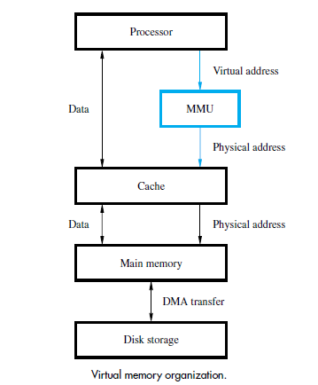
Virtual Memory Organization
Introducing the MMU (Memory Management Unit)
The MMU
Keeps track of which parts of the virtual address space are in the physical memory
Translates Virtual Addresses into Physical Addresses
Case 1: The Data that is wanted is In MM
The MMU translates V-Address into P-Address
Case 2: The Data is NOT in MM
The MMU causes the OS to transfer data from Disk to MM
Notes:
Now suppose, as in this example, that there are not sufficient unused contiguous
frames to hold the process. Does this prevent the OS from loading A?
The answer is no, because we can once again use the concept of logical address. A
simple base address will no longer suffice. Rather, the OS maintains a page table
for each process. The page table shows the frame location for each page of the
process. Within the program, each logical address consists of a page number and
a relative address within the page. Recall that in the case of simple partitioning, a
logical address is the location of a word relative to the beginning of the program;
the processor translates that into a physical address. With paging, the logical-to-
physical address translation is still done by processor hardware. The processor
must know how to access the page table of the current process. Presented with a
logical address (page number, relative address), the processor uses the page table
to produce a physical address (frame number, relative address). An example is
shown in Figure 8.16.
This approach solves the problems raised earlier. Main memory is divided
into many small equal-size frames. Each process is divided into frame-size pages:
smaller processes require fewer pages, larger processes require more. When a
process is brought in, its pages are loaded into available frames, and a page table
is set up.

Slide 9
Virtual Memory – Address Translation
One methods (a simple one), assumes the following:
All programs are composed of fixed-length units called pages, each of which consists of a block of words that occupy contiguous locations in Main Memory
Pages range from 2K to 16K bytes in length
Pages are the basic unit of info that is transferred between MM & Disk when the MMU determines that a transfer is required
Notes:
With the use of paging, truly effective multiprogramming
systems came into being. Furthermore, the simple tactic of breaking a process up
into pages led to the development of another important concept: virtual memory.
To understand virtual memory, we must add a refinement to the paging
scheme just discussed. That refinement is demand paging, which simply means that
each page of a process is brought in only when it is needed, that is, on demand.
Consider a large process, consisting of a long program plus a number of arrays
of data. Over any short period of time, execution may be confined to a small section
of the program (e.g., a subroutine), and perhaps only one or two arrays of data
are being used. This is the principle of locality, which we introduced in Appendix
4A. It would clearly be wasteful to load in dozens of pages for that process when
only a few pages will be used before the program is suspended. We can make better
use of memory by loading in just a few pages. Then, if the program branches
to an instruction on a page not in main memory, or if the program references data
on a page not in memory, a page fault is triggered. This tells the OS to bring in the
desired page.
Thus, at any one time, only a few pages of any given process are in memory,
and therefore more processes can be maintained in memory. Furthermore, time is
saved because unused pages are not swapped in and out of memory. However, the
OS must be clever about how it manages this scheme. When it brings one page in, it
must throw another page out; this is known as page replacement. If it throws out a
page just before it is about to be used, then it will just have to go get that page again
almost immediately. Too much of this leads to a condition known as thrashing: the
processor spends most of its time swapping pages rather than executing instructions.
The avoidance of thrashing was a major research area in the 1970s and led to a variety
of complex but effective algorithms. In essence, the OS tries to guess, based on
recent history, which pages are least likely to be used in the near future.
With demand paging, it is not necessary to load an entire process into main
memory. This fact has a remarkable consequence: It is possible for a process to be
larger than all of main memory. One of the most fundamental restrictions in programming
has been lifted. Without demand paging, a programmer must be acutely
aware of how much memory is available. If the program being written is too large,
the programmer must devise ways to structure the program into pieces that can
be loaded one at a time. With demand paging, that job is left to the OS and the
hardware. As far as the programmer is concerned, he or she is dealing with a huge
memory, the size associated with disk storage.
Because a process executes only in main memory, that memory is referred to
as real memory. But a programmer or user perceives a much larger memory—that
which is allocated on the disk. This latter is therefore referred to as virtual memory.
Virtual memory allows for very effective multiprogramming and relieves the user of
the unnecessarily tight constraints of main memory.

Slide 10
Virtual Memory – Address Translation
What is the right size for a page?
Not too small
The access time to magnetic disk is very large (several milliseconds) compared to the access time of Main memory. If you bring to few info, probably very soon you will have to do it again to bring more and necessary information.
Not too Big
If your bring more info that what you need, there is a high chance that you will occupy useful MM space with data that will not be used
Notes:
Both unequal fixed-size and variable-size partitions are inefficient in the use of
memory. Suppose, however, that memory is partitioned into equal fixed-size chunks
that are relatively small, and that each process is also divided into small fixed-size
chunks of some size. Then the chunks of a program, known as pages, could be
assigned to available chunks of memory, known as frames, or page frames. At most,
then, the wasted space in memory for that process is a fraction of the last page.
Figure 8.15 shows an example of the use of pages and frames. At a given point
in time, some of the frames in memory are in use and some are free. The list of free
frames is maintained by the OS. Process A, stored on disk, consists of four pages.
When it comes time to load this process, the OS finds four free frames and loads the
four pages of the process A into the four frames.

Slide 11
Virtual Memory
Demand Paging
Principle of locality
When working with a large process; execution may be confined to a small section of a program (subroutine)
It is better use of memory to load in just a few pages
If the program references data or branches to an instruction on a page NOT in main memory, a page fault is triggered which tells the OS to bring in the desired page
Advantages:
More processes can be maintained in memory
Time is saved because unused pages are not swapped in and out of memory
Disadvantages:
When one page is brought in, another page must be thrown out (page replacement)
If a page is thrown out just before it is about to be used the OS will have to go get the page again (Thrashing)
When the processor spends most of its time swapping pages rather than executing instructions
Notes:
With the use of paging, truly effective multiprogramming
systems came into being. Furthermore, the simple tactic of breaking a process up
into pages led to the development of another important concept: virtual memory.
To understand virtual memory, we must add a refinement to the paging
scheme just discussed. That refinement is demand paging, which simply means that
each page of a process is brought in only when it is needed, that is, on demand.
Consider a large process, consisting of a long program plus a number of arrays
of data. Over any short period of time, execution may be confined to a small section
of the program (e.g., a subroutine), and perhaps only one or two arrays of data
are being used. This is the principle of locality, which we introduced in Appendix
4A. It would clearly be wasteful to load in dozens of pages for that process when
only a few pages will be used before the program is suspended. We can make better
use of memory by loading in just a few pages. Then, if the program branches
to an instruction on a page not in main memory, or if the program references data
on a page not in memory, a page fault is triggered. This tells the OS to bring in the
desired page.
Thus, at any one time, only a few pages of any given process are in memory,
and therefore more processes can be maintained in memory. Furthermore, time is
saved because unused pages are not swapped in and out of memory. However, the
OS must be clever about how it manages this scheme. When it brings one page in, it
must throw another page out; this is known as page replacement. If it throws out a
page just before it is about to be used, then it will just have to go get that page again
almost immediately. Too much of this leads to a condition known as thrashing: the
processor spends most of its time swapping pages rather than executing instructions.
The avoidance of thrashing was a major research area in the 1970s and led to a variety
of complex but effective algorithms. In essence, the OS tries to guess, based on
recent history, which pages are least likely to be used in the near future.
With demand paging, it is not necessary to load an entire process into main
memory. This fact has a remarkable consequence: It is possible for a process to be
larger than all of main memory. One of the most fundamental restrictions in programming
has been lifted. Without demand paging, a programmer must be acutely
aware of how much memory is available. If the program being written is too large,
the programmer must devise ways to structure the program into pieces that can
be loaded one at a time. With demand paging, that job is left to the OS and the
hardware. As far as the programmer is concerned, he or she is dealing with a huge
memory, the size associated with disk storage.
Because a process executes only in main memory, that memory is referred to
as real memory. But a programmer or user perceives a much larger memory—that
which is allocated on the disk. This latter is therefore referred to as virtual memory.
Virtual memory allows for very effective multiprogramming and relieves the user of
the unnecessarily tight constraints of main memory.

Slide 12
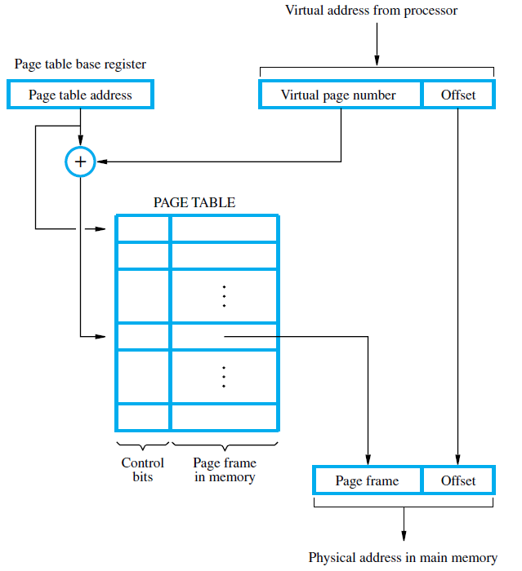
Notes:
Now suppose, as in this example, that there are not sufficient unused contiguous
frames to hold the process. Does this prevent the OS from loading A?
The answer is no, because we can once again use the concept of logical address. A
simple base address will no longer suffice. Rather, the OS maintains a page table
for each process. The page table shows the frame location for each page of the
process. Within the program, each logical address consists of a page number and
a relative address within the page. Recall that in the case of simple partitioning, a
logical address is the location of a word relative to the beginning of the program;
the processor translates that into a physical address. With paging, the logical-to-
physical address translation is still done by processor hardware. The processor
must know how to access the page table of the current process. Presented with a
logical address (page number, relative address), the processor uses the page table
to produce a physical address (frame number, relative address). An example is
shown in Figure 8.16.
This approach solves the problems raised earlier. Main memory is divided
into many small equal-size frames. Each process is divided into frame-size pages:
smaller processes require fewer pages, larger processes require more. When a
process is brought in, its pages are loaded into available frames, and a page table
is set up.

Slide 13
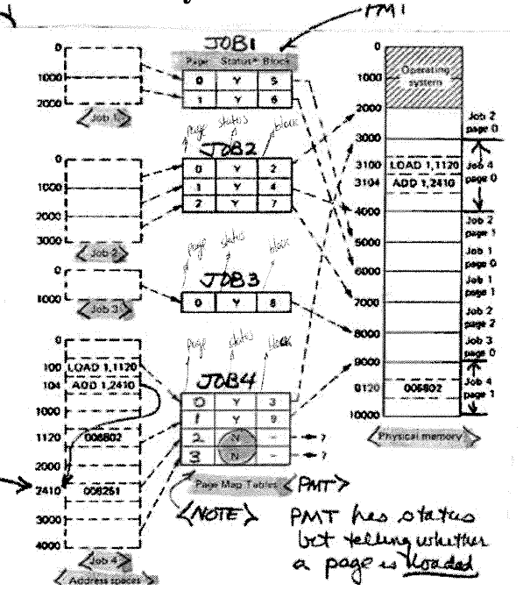
Notes:
The basic mechanism for reading a word from memory
involves the translation of a virtual, or logical, address, consisting of page number
and offset, into a physical address, consisting of frame number and offset, using a
page table. Because the page table is of variable length, depending on the size of the
process, we cannot expect to hold it in registers. Instead, it must be in main memory
to be accessed. Figure 8.16 suggests a hardware implementation of this scheme.
When a particular process is running, a register holds the starting address of the
page table for that process. The page number of a virtual address is used to index
that table and look up the corresponding frame number. This is combined with the
offset portion of the virtual address to produce the desired real address.
In most systems, there is one page table per process. But each process can
occupy huge amounts of virtual memory. For example, in the VAX architecture,
each process can have up to 2³¹ = 2 Gbytes of virtual memory. Using 2⁹ = 512-byte
pages, that means that as many as 2²² page table entries are required per process.
Clearly, the amount of memory devoted to page tables alone could be unacceptably
high. To overcome this problem, most virtual memory schemes store page tables in
virtual memory rather than real memory. This means that page tables are subject to
paging just as other pages are. When a process is running, at least a part of its page
table must be in main memory, including the page table entry of the currently executing
page. Some processors make use of a two-level scheme to organize large page
tables. In this scheme, there is a page directory, in which each entry points to a page
table. Thus, if the length of the page directory is X, and if the maximum length of a
page table is Y, then a process can consist of up to X * Y pages. Typically, the maximum
length of a page table is restricted to be equal to one page. We will see an example
of this two-level approach when we consider the Pentium II later in this chapter.

Slide 14
TLB (Table Lookaside Buffer)
Notes:
Both unequal fixed-size and variable-size partitions are inefficient in the use of
memory. Suppose, however, that memory is partitioned into equal fixed-size chunks
that are relatively small, and that each process is also divided into small fixed-size
chunks of some size. Then the chunks of a program, known as pages, could be
assigned to available chunks of memory, known as frames, or page frames. At most,
then, the wasted space in memory for that process is a fraction of the last page.
Figure 8.15 shows an example of the use of pages and frames. At a given point
in time, some of the frames in memory are in use and some are free. The list of free
frames is maintained by the OS. Process A, stored on disk, consists of four pages.
When it comes time to load this process, the OS finds four free frames and loads the
four pages of the process A into the four frames.

Slide 15
Operation of Paging and Translation Lookaside Buffer (TLB)
In principle: every virtual reference can cause two physical memory accesses:
One to prefetch the appropriate page table
And one to fetch the desired data.
THIS IS NOT GOOD → 2X the memory access time.
So what do we do to avoid this ?? → We use Special Cache → TLB
Similar to cache memory
Contains those page table entries that have been more recently used.
Notes:
In principle, then, every virtual memory reference can cause two physical memory
accesses: one to fetch the appropriate page table entry, and one to fetch the
desired data. Thus, a straightforward virtual memory scheme would have the effect
of doubling the memory access time. To overcome this problem, most virtual
memory schemes make use of a special cache for page table entries, usually called
a translation lookaside buffer (TLB). This cache functions in the same way as a
memory cache and contains those page table entries that have been most recently
used. Figure 8.18 is a flowchart that shows the use of the TLB. By the principle of
locality, most virtual memory references will be to locations in recently used pages.
Therefore, most references will involve page table entries in the cache. Studies of
the VAX TLB have shown that this scheme can significantly improve performance
[CLAR85, SATY81].

Slide 16
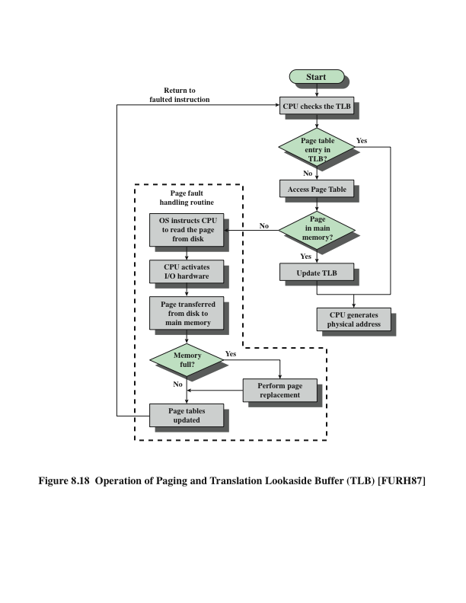
Operation of Paging and Translation Lookaside Buffer (TLB)
Notes:
In principle, then, every virtual memory reference can cause two physical memory
accesses: one to fetch the appropriate page table entry, and one to fetch the
desired data. Thus, a straightforward virtual memory scheme would have the effect
of doubling the memory access time. To overcome this problem, most virtual
memory schemes make use of a special cache for page table entries, usually called
a translation lookaside buffer (TLB). This cache functions in the same way as a
memory cache and contains those page table entries that have been most recently
used. Figure 8.18 is a flowchart that shows the use of the TLB. By the principle of
locality, most virtual memory references will be to locations in recently used pages.
Therefore, most references will involve page table entries in the cache. Studies of
the VAX TLB have shown that this scheme can significantly improve performance
[CLAR85, SATY81].

Slide 17
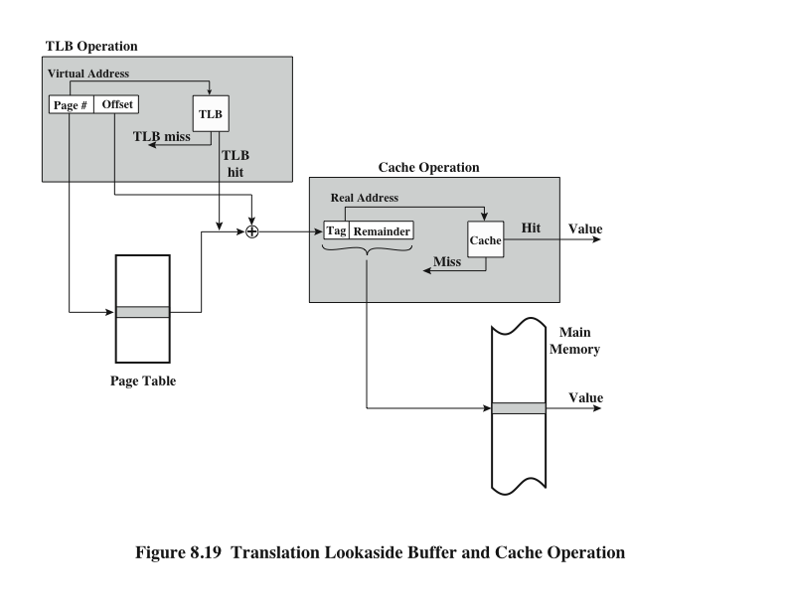
TLB and Cache Operation
Notes:
Note that the virtual memory mechanism must interact with the cache system
(not the TLB cache, but the main memory cache). This is illustrated in Figure 8.19.
A virtual address will generally be in the form of a page number, offset. First, the
memory system consults the TLB to see if the matching page table entry is present.
If it is, the real (physical) address is generated by combining the frame number with
the offset. If not, the entry is accessed from a page table. Once the real address is
generated, which is in the form of a tag and a remainder, the cache is consulted to
see if the block containing that word is present (see Figure 4.5). If so, it is returned
to the processor. If not, the word is retrieved from main memory.
The reader should be able to appreciate the complexity of the processor hardware
involved in a single memory reference. The virtual address is translated into
a real address. This involves reference to a page table, which may be in the TLB, in
main memory, or on disk. The referenced word may be in cache, in main memory,
or on disk. In the latter case, the page containing the word must be loaded into main
memory and its block loaded into the cache. In addition, the page table entry for
that page must be updated.

Slide 18
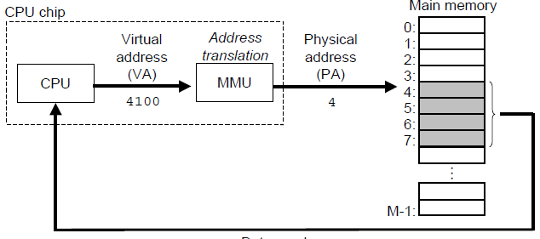
Virtual Memory (REVIEW)
Virtual Address (VA) = Logical Address
(Page #, Offset)
Virtual means fictitious, we only have Physical Addresses.
Physical Address (PA) (Real Main Memory Addresses)
(Frame, Offset)
We need to be able to go from VA to PA
[VA] (Page #, Offset) → [PA] (Frame, Offset)
Remember
Process(job) → divided into parts called Pages
Main Memory → divided into Page Frames (Frames)
Notes:
With the use of paging, truly effective multiprogramming
systems came into being. Furthermore, the simple tactic of breaking a process up
into pages led to the development of another important concept: virtual memory.
To understand virtual memory, we must add a refinement to the paging
scheme just discussed. That refinement is demand paging, which simply means that
each page of a process is brought in only when it is needed, that is, on demand.
Consider a large process, consisting of a long program plus a number of arrays
of data. Over any short period of time, execution may be confined to a small section
of the program (e.g., a subroutine), and perhaps only one or two arrays of data
are being used. This is the principle of locality, which we introduced in Appendix
4A. It would clearly be wasteful to load in dozens of pages for that process when
only a few pages will be used before the program is suspended. We can make better
use of memory by loading in just a few pages. Then, if the program branches
to an instruction on a page not in main memory, or if the program references data
on a page not in memory, a page fault is triggered. This tells the OS to bring in the
desired page.
Thus, at any one time, only a few pages of any given process are in memory,
and therefore more processes can be maintained in memory. Furthermore, time is
saved because unused pages are not swapped in and out of memory. However, the
OS must be clever about how it manages this scheme. When it brings one page in, it
must throw another page out; this is known as page replacement. If it throws out a
page just before it is about to be used, then it will just have to go get that page again
almost immediately. Too much of this leads to a condition known as thrashing: the
processor spends most of its time swapping pages rather than executing instructions.
The avoidance of thrashing was a major research area in the 1970s and led to a variety
of complex but effective algorithms. In essence, the OS tries to guess, based on
recent history, which pages are least likely to be used in the near future.
With demand paging, it is not necessary to load an entire process into main
memory. This fact has a remarkable consequence: It is possible for a process to be
larger than all of main memory. One of the most fundamental restrictions in programming
has been lifted. Without demand paging, a programmer must be acutely
aware of how much memory is available. If the program being written is too large,
the programmer must devise ways to structure the program into pieces that can
be loaded one at a time. With demand paging, that job is left to the OS and the
hardware. As far as the programmer is concerned, he or she is dealing with a huge
memory, the size associated with disk storage.
Because a process executes only in main memory, that memory is referred to
as real memory. But a programmer or user perceives a much larger memory—that
which is allocated on the disk. This latter is therefore referred to as virtual memory.
Virtual memory allows for very effective multiprogramming and relieves the user of
the unnecessarily tight constraints of main memory.

Slide 19
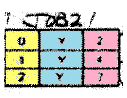
Virtual Memory
Page Table
Usually ONE per process (job)
Each Location in a Page Table is known as a Page Table Entry (PTE)
A page table can have multiple PTE’s
The structure of a Page Table Entry
(Page, Frame, Valid Bit)
Page → Small fraction of a job (Remember definition)
Frame → Where in Main Memory
Valid Bit → Related to current status of its VM location
Notes:
With the use of paging, truly effective multiprogramming
systems came into being. Furthermore, the simple tactic of breaking a process up
into pages led to the development of another important concept: virtual memory.
To understand virtual memory, we must add a refinement to the paging
scheme just discussed. That refinement is demand paging, which simply means that
each page of a process is brought in only when it is needed, that is, on demand.
Consider a large process, consisting of a long program plus a number of arrays
of data. Over any short period of time, execution may be confined to a small section
of the program (e.g., a subroutine), and perhaps only one or two arrays of data
are being used. This is the principle of locality, which we introduced in Appendix
4A. It would clearly be wasteful to load in dozens of pages for that process when
only a few pages will be used before the program is suspended. We can make better
use of memory by loading in just a few pages. Then, if the program branches
to an instruction on a page not in main memory, or if the program references data
on a page not in memory, a page fault is triggered. This tells the OS to bring in the
desired page.
Thus, at any one time, only a few pages of any given process are in memory,
and therefore more processes can be maintained in memory. Furthermore, time is
saved because unused pages are not swapped in and out of memory. However, the
OS must be clever about how it manages this scheme. When it brings one page in, it
must throw another page out; this is known as page replacement. If it throws out a
page just before it is about to be used, then it will just have to go get that page again
almost immediately. Too much of this leads to a condition known as thrashing: the
processor spends most of its time swapping pages rather than executing instructions.
The avoidance of thrashing was a major research area in the 1970s and led to a variety
of complex but effective algorithms. In essence, the OS tries to guess, based on
recent history, which pages are least likely to be used in the near future.
With demand paging, it is not necessary to load an entire process into main
memory. This fact has a remarkable consequence: It is possible for a process to be
larger than all of main memory. One of the most fundamental restrictions in programming
has been lifted. Without demand paging, a programmer must be acutely
aware of how much memory is available. If the program being written is too large,
the programmer must devise ways to structure the program into pieces that can
be loaded one at a time. With demand paging, that job is left to the OS and the
hardware. As far as the programmer is concerned, he or she is dealing with a huge
memory, the size associated with disk storage.
Because a process executes only in main memory, that memory is referred to
as real memory. But a programmer or user perceives a much larger memory—that
which is allocated on the disk. This latter is therefore referred to as virtual memory.
Virtual memory allows for very effective multiprogramming and relieves the user of
the unnecessarily tight constraints of main memory.

Slide 20
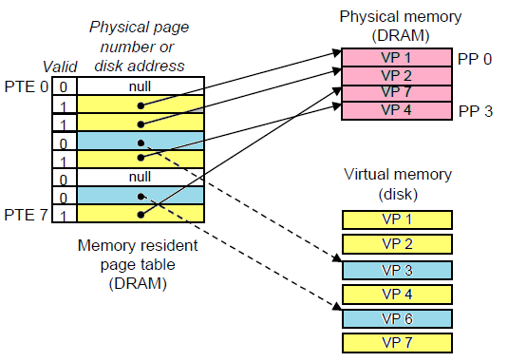
Virtual Memory
Page Table
Valid Bit → Related to current status of its VM location
Notes:
With the use of paging, truly effective multiprogramming
systems came into being. Furthermore, the simple tactic of breaking a process up
into pages led to the development of another important concept: virtual memory.
To understand virtual memory, we must add a refinement to the paging
scheme just discussed. That refinement is demand paging, which simply means that
each page of a process is brought in only when it is needed, that is, on demand.
Consider a large process, consisting of a long program plus a number of arrays
of data. Over any short period of time, execution may be confined to a small section
of the program (e.g., a subroutine), and perhaps only one or two arrays of data
are being used. This is the principle of locality, which we introduced in Appendix
4A. It would clearly be wasteful to load in dozens of pages for that process when
only a few pages will be used before the program is suspended. We can make better
use of memory by loading in just a few pages. Then, if the program branches
to an instruction on a page not in main memory, or if the program references data
on a page not in memory, a page fault is triggered. This tells the OS to bring in the
desired page.
Thus, at any one time, only a few pages of any given process are in memory,
and therefore more processes can be maintained in memory. Furthermore, time is
saved because unused pages are not swapped in and out of memory. However, the
OS must be clever about how it manages this scheme. When it brings one page in, it
must throw another page out; this is known as page replacement. If it throws out a
page just before it is about to be used, then it will just have to go get that page again
almost immediately. Too much of this leads to a condition known as thrashing: the
processor spends most of its time swapping pages rather than executing instructions.
The avoidance of thrashing was a major research area in the 1970s and led to a variety
of complex but effective algorithms. In essence, the OS tries to guess, based on
recent history, which pages are least likely to be used in the near future.
With demand paging, it is not necessary to load an entire process into main
memory. This fact has a remarkable consequence: It is possible for a process to be
larger than all of main memory. One of the most fundamental restrictions in programming
has been lifted. Without demand paging, a programmer must be acutely
aware of how much memory is available. If the program being written is too large,
the programmer must devise ways to structure the program into pieces that can
be loaded one at a time. With demand paging, that job is left to the OS and the
hardware. As far as the programmer is concerned, he or she is dealing with a huge
memory, the size associated with disk storage.
Because a process executes only in main memory, that memory is referred to
as real memory. But a programmer or user perceives a much larger memory—that
which is allocated on the disk. This latter is therefore referred to as virtual memory.
Virtual memory allows for very effective multiprogramming and relieves the user of
the unnecessarily tight constraints of main memory.

Slide 21
Virtual Memory
Why are Page Tables subject to Paging, just like any other page?
Let’s look at this example:
In the case of the VAX architecture a process (job) can have up to 2^31 = 2 GB of VM.
Imagine we use 2^9 = 512 byte pages
Means that the Page Table for this process(job) will need 2^22 page tables entries
Page Tables are a data structure, we do not want to store all this in MM. We only want in MM the parts with information that is related to what we are using (increase locality).
Notes:
With the use of paging, truly effective multiprogramming
systems came into being. Furthermore, the simple tactic of breaking a process up
into pages led to the development of another important concept: virtual memory.
To understand virtual memory, we must add a refinement to the paging
scheme just discussed. That refinement is demand paging, which simply means that
each page of a process is brought in only when it is needed, that is, on demand.
Consider a large process, consisting of a long program plus a number of arrays
of data. Over any short period of time, execution may be confined to a small section
of the program (e.g., a subroutine), and perhaps only one or two arrays of data
are being used. This is the principle of locality, which we introduced in Appendix
4A. It would clearly be wasteful to load in dozens of pages for that process when
only a few pages will be used before the program is suspended. We can make better
use of memory by loading in just a few pages. Then, if the program branches
to an instruction on a page not in main memory, or if the program references data
on a page not in memory, a page fault is triggered. This tells the OS to bring in the
desired page.
Thus, at any one time, only a few pages of any given process are in memory,
and therefore more processes can be maintained in memory. Furthermore, time is
saved because unused pages are not swapped in and out of memory. However, the
OS must be clever about how it manages this scheme. When it brings one page in, it
must throw another page out; this is known as page replacement. If it throws out a
page just before it is about to be used, then it will just have to go get that page again
almost immediately. Too much of this leads to a condition known as thrashing: the
processor spends most of its time swapping pages rather than executing instructions.
The avoidance of thrashing was a major research area in the 1970s and led to a variety
of complex but effective algorithms. In essence, the OS tries to guess, based on
recent history, which pages are least likely to be used in the near future.
With demand paging, it is not necessary to load an entire process into main
memory. This fact has a remarkable consequence: It is possible for a process to be
larger than all of main memory. One of the most fundamental restrictions in programming
has been lifted. Without demand paging, a programmer must be acutely
aware of how much memory is available. If the program being written is too large,
the programmer must devise ways to structure the program into pieces that can
be loaded one at a time. With demand paging, that job is left to the OS and the
hardware. As far as the programmer is concerned, he or she is dealing with a huge
memory, the size associated with disk storage.
Because a process executes only in main memory, that memory is referred to
as real memory. But a programmer or user perceives a much larger memory—that
which is allocated on the disk. This latter is therefore referred to as virtual memory.
Virtual memory allows for very effective multiprogramming and relieves the user of
the unnecessarily tight constraints of main memory.

Slide 22
Notes:
The basic mechanism for reading a word from memory
involves the translation of a virtual, or logical, address, consisting of page number
and offset, into a physical address, consisting of frame number and offset, using a
page table. Because the page table is of variable length, depending on the size of the
process, we cannot expect to hold it in registers. Instead, it must be in main memory
to be accessed. Figure 8.16 suggests a hardware implementation of this scheme.
When a particular process is running, a register holds the starting address of the
page table for that process. The page number of a virtual address is used to index
that table and look up the corresponding frame number. This is combined with the
offset portion of the virtual address to produce the desired real address.
In most systems, there is one page table per process. But each process can
occupy huge amounts of virtual memory. For example, in the VAX architecture,
each process can have up to 2³¹ = 2 Gbytes of virtual memory. Using 2⁹ = 512-byte
pages, that means that as many as 2²² page table entries are required per process.
Clearly, the amount of memory devoted to page tables alone could be unacceptably
high. To overcome this problem, most virtual memory schemes store page tables in
virtual memory rather than real memory. This means that page tables are subject to
paging just as other pages are. When a process is running, at least a part of its page
table must be in main memory, including the page table entry of the currently executing
page. Some processors make use of a two-level scheme to organize large page
tables. In this scheme, there is a page directory, in which each entry points to a page
table. Thus, if the length of the page directory is X, and if the maximum length of a
page table is Y, then a process can consist of up to X * Y pages. Typically, the maximum
length of a page table is restricted to be equal to one page. We will see an example
of this two-level approach when we consider the Pentium II later in this chapter.

Slide 23
Problem # 1
In a system with 64 bit Virtual Addresses, and 43 bit physical addresses, how many bits are required for:
# of Bits for Virtual Page Number (VPN)?
# of Bits Physical Page Number (PPN)?
Pages are 8KB in size
Notes:
Both unequal fixed-size and variable-size partitions are inefficient in the use of
memory. Suppose, however, that memory is partitioned into equal fixed-size chunks
that are relatively small, and that each process is also divided into small fixed-size
chunks of some size. Then the chunks of a program, known as pages, could be
assigned to available chunks of memory, known as frames, or page frames. At most,
then, the wasted space in memory for that process is a fraction of the last page.
Figure 8.15 shows an example of the use of pages and frames. At a given point
in time, some of the frames in memory are in use and some are free. The list of free
frames is maintained by the OS. Process A, stored on disk, consists of four pages.
When it comes time to load this process, the OS finds four free frames and loads the
four pages of the process A into the four frames.

Slide 24
Problem # 2
Processor X has 32 bit Virtual addresses, 28 bit physical addresses, and 2048 bit pages. How many bits are required for the virtual and physical page numbers
# of Bits for Virtual Page Number (VPN)?
# of Bits Physical Page Number (PPN)?
Pages are 2048 bits in size
Notes:
Both unequal fixed-size and variable-size partitions are inefficient in the use of
memory. Suppose, however, that memory is partitioned into equal fixed-size chunks
that are relatively small, and that each process is also divided into small fixed-size
chunks of some size. Then the chunks of a program, known as pages, could be
assigned to available chunks of memory, known as frames, or page frames. At most,
then, the wasted space in memory for that process is a fraction of the last page.
Figure 8.15 shows an example of the use of pages and frames. At a given point
in time, some of the frames in memory are in use and some are free. The list of free
frames is maintained by the OS. Process A, stored on disk, consists of four pages.
When it comes time to load this process, the OS finds four free frames and loads the
four pages of the process A into the four frames.

Slide 25
Problem # 3
A system has 48 bit Virtual Addresses, 36 Bit Physical
addresses, and 128 MB of Main Memory.
If the system uses 4096 bytes per page, how many:
# of Virtual and Physical pages can the address spaces support?
How many page frames of main memory are there?
Notes:
Both unequal fixed-size and variable-size partitions are inefficient in the use of
memory. Suppose, however, that memory is partitioned into equal fixed-size chunks
that are relatively small, and that each process is also divided into small fixed-size
chunks of some size. Then the chunks of a program, known as pages, could be
assigned to available chunks of memory, known as frames, or page frames. At most,
then, the wasted space in memory for that process is a fraction of the last page.
Figure 8.15 shows an example of the use of pages and frames. At a given point
in time, some of the frames in memory are in use and some are free. The list of free
frames is maintained by the OS. Process A, stored on disk, consists of four pages.
When it comes time to load this process, the OS finds four free frames and loads the
four pages of the process A into the four frames.

Slide 26
Homework
It will be released today (Easy).
Scanned copy:
Due 11/20th Monday at noon, via D2L.
Last day to ask questions: Tomorrow 3 pm
Hard-copy:
Due at 8:00 am in class, 11/21
Clean, organized, presentable ~ GRADE
Both MUST MATCH
Notes:
Both unequal fixed-size and variable-size partitions are inefficient in the use of
memory. Suppose, however, that memory is partitioned into equal fixed-size chunks
that are relatively small, and that each process is also divided into small fixed-size
chunks of some size. Then the chunks of a program, known as pages, could be
assigned to available chunks of memory, known as frames, or page frames. At most,
then, the wasted space in memory for that process is a fraction of the last page.
Figure 8.15 shows an example of the use of pages and frames. At a given point
in time, some of the frames in memory are in use and some are free. The list of free
frames is maintained by the OS. Process A, stored on disk, consists of four pages.
When it comes time to load this process, the OS finds four free frames and loads the
four pages of the process A into the four frames.

Slide 27
Memory Placement Algorithms
Students are advised to keep this video for your records. This video will be played in class only once; however, you (students) are advised to watch it as many times as necessary until you fully understand these concepts.
https://www.youtube.com/watch?v=GNzUL200Fko

